Slide 1
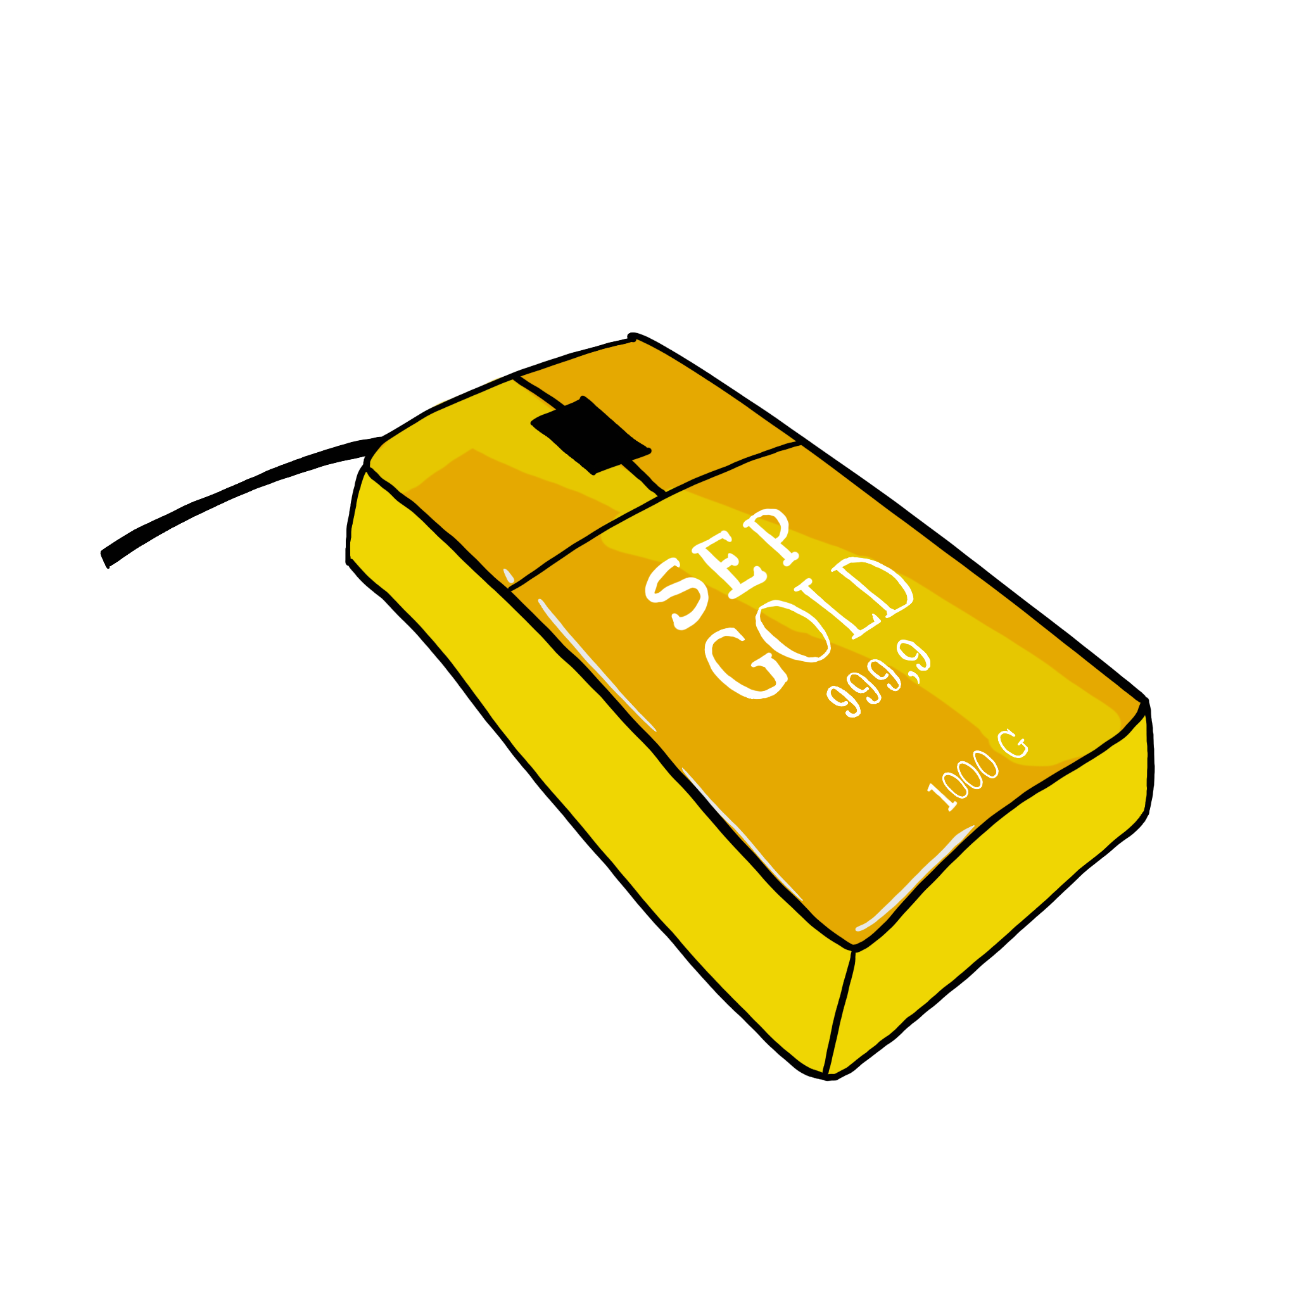

Slide 2
SEP Week 2
Project Init &
Software Processes
(thanks to Simon Lock, whose slides I’ve adapted for some of this lecture)

Slide 3
What the team agreement is
A short file in your repo, docs/team-agreement.md, where the whole team records how you will work together.
Five decisions about how you run the team
Agreed by everyone
Versioned in git
A working document you revise as you learn
Notes:
Keep this short: the point is that it's a practical file, not an essay. It lives in the repo next to the code, so changes are tracked the same way. Everything in it is a decision someone can act on: who decides when you disagree, how work is handed out, what counts as done, what happens when someone goes quiet, and who writes the decision records. If a sentence in it couldn't settle an argument, it probably doesn't belong there.

Slide 4
The team agreement
HOW, ACROSS THE YEAR
Decide now, not in a crisis
Week 2 · Thu 1 Oct
Define Team Agreement
while everyone is fresh
Any time
Change it when it stops working; log via github;
Head off the common failures
Week 9
One member who does nothing, or a member who decides everything.
Team review presentation
Week 13
evidence of how you collaborate
Review at the TB2 reset
The agreement and every revision live in your repo
Final viva
Explain how it worked and what you changed
Notes:
This isn't a mission statement. It's a handful of decisions that are much easier to make in week 2 than in March. The two failure modes we see every year are the person who disappears and the person who ends up running everything; the agreement gives both an owner from the start. It isn't a one-off form: you revisit it at the first team review in week 9, you re-contract at the start of TB2, and any change in between is recorded like any other decision. Revisions are dated by git, so a living agreement that you adjusted in response to real problems is exactly what we want to see at the viva. An agreement nobody opened again is not.

Slide 5
Client Collaboration Agreement
The Contract
Should be signed by client and you by
13:00 THURSDAY 22nd OCTOBER (Week 5)
A number of different contracts on Blackboard
Need help? Come to the Drop in!

Slide 6
Project Collaboration Agreement
The Contract
Should be signed by client and you by
13:00 THURSDAY 22nd OCTOBER (Week 5)
A number of different contracts on Blackboard

Slide 7
Project Collaboration Agreement
Read and understand it, and flag to the client that they need to get it signed
Problems? Questions? Come to the Drop in!

Slide 8
Project Collaboration Agreement
DO NOT SIGN ANYTHING ELSE!!
NEVER SIGN A NON DISCLOSURE AGREEMENT!!!!
If clients ask you to, email me!

Slide 9
Pre-meeting Prep
Do you understand the brief?
Describe the project for your ReadMe file
Identify stakeholders
Write some initial user stories
  As a <type of user> I want to <achieve a goal> so that <a reason>.

Slide 10
Ethics task
Must be done by
13:00 THURSDAY 22nd OCTOBER (Week 5)

Slide 11
What are we doing today?
Learning about basics of software development processes…
… So you can meet your team tomorrow, and start work!

Slide 12
A weird metaphor
Developing software is a bit like cooking:
Chefs (Developers)
follow a recipe (process)
To cook a meal for hungry diners (clients)

Slide 13
More metaphor
Up until now, you’ve mostly been ‘freestyling’
(cooking without a recipe)
Creating meals for yourself
Or to feed friends and family (lecturers!)
But now you need to cook ‘commercially’
For paying customers

Slide 14
More metphor
For the best chance of success, we need
Talented chefs
(who can follow a clearly defined recipe and work together)
A clear recipe
(that defines what we should be doing when)
Decisive diners
(who can make up their minds what they want to eat!)

Slide 15
Different kinds of restaurants
Different restaurants run different types of kitchen
• You won't expect a burger bar to cook in the same way has a high-end restaurant
• Similarly, developers build in different ways for different products and markets
• You won't expect an autonomous car to be built in the same way as social media app!

Slide 16
Different kinds of systems
Mobile productivity apps
Stand-alone desktop applications
Transaction-based networked applications
Embedded control systems
Data collection and monitoring systems
Batch processing systems
Entertainment and education apps
Systems for modelling and simulation
Games
Etc

Slide 17
“THE” Software Development process
No such thing as "THE" software dev process!
Different domains rely upon different processes
Different companies have own in-house standards
Similar concepts can have different names
Different experts advocate their own approach
All will try and convince you that theirs is the best!

Slide 18
Standardisation
There is limited agreement/standardisation
We’ll try to put across something coherent
Present some key concepts and processes
Might differ from what your client advocates
Might differ from what you do when you graduate
But majority of the fundamentals you will recognise

Slide 19
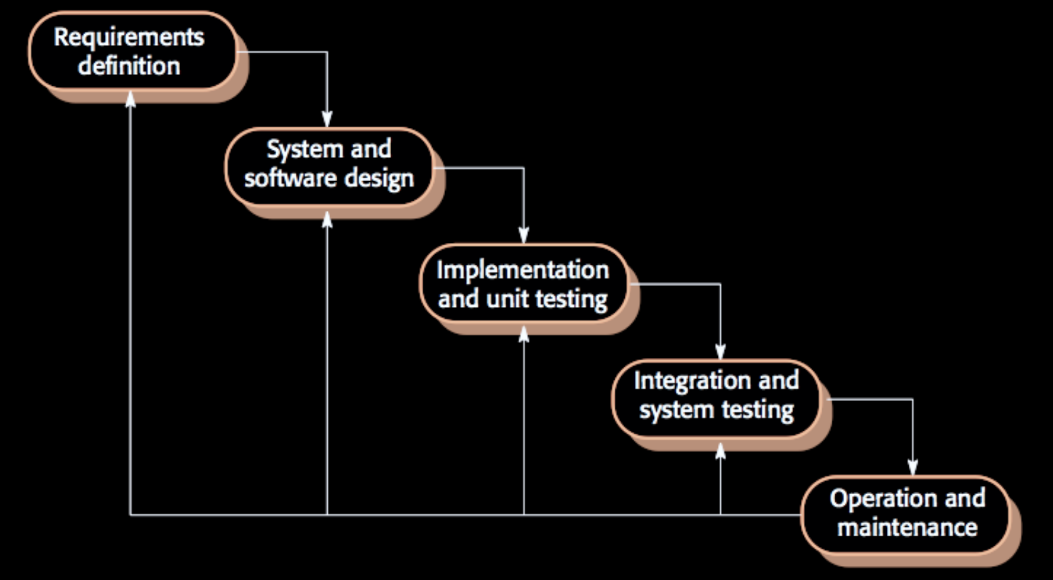
Waterfall model

Slide 20
Requirements defintion
• What should the system do?
• What are the needs of the users?
• What are the needs of the host organisation?
• What are interoperability needs of existing systems?

Slide 21
Requirements
Requirements
We need to think about functional elements
(stuff that system should do)
And also non-functional elements
(quality and properties of system operation)
Security, Reliability, Ease of Use, Maintainability etc.

Slide 22
Design
Before we implement anything, we need an overall structure for the system
• What objects, architectures, files, databases, servers, services etc. should we create ?
• Only then do we know the places where requirements should be implemented
• Also helps divide up work between team members.

Slide 23
Implementation
You are familiar with programming, but there is more to implementation than just “cutting code”…
• Parallel working and code sharing
• API partitioning and “firewalling”
• Versioning, integration and config management
• Development environments and automated build
• Automated testing
Docs and training material also need writing!

Slide 24
Verification and Validation
Demonstrates that system meets needs of client
Involves checking, reviewing, evaluating & testing
Testing is the most common V & V activity
So you’ll be doing plenty of that!
User evaluation is the most undervalued
You’ll come up with excuses why you didn’t do it :-D

Slide 25
Waterfall model

Slide 26
Realism
People dis waterfall model as naïve and unrealistic
But remember - it's a simplification & abstraction
A tool to help explain activities of SW development
Useful for undergrad Computer Science courses!
It's not exactly what happens in the real world,
But it is a good start in trying to understand it!

Slide 27
Agile Development
Agile is NOT a development process
It is a philosophy - a way of thinking
The Agile "Manifesto" promotes the following values:
• Individuals & Interactions (over processes & tools)
• Operational Software (over documentation)
• Customer Collaboration (over formal contracts)
• Responding to Change (over predefined plan)

Slide 28
Agile is a way of mind
It made old-school devs very nervous !
The values are however intended as "provocations"…
Get us to rethink and reassess our preconceptions
They don't ask us to totally disregard certain things
(such as processes, tools, documentation etc)
But rather, think about other aspects AS WELL

Slide 29
Agile is a development methodology
devised by (and for use by) coders!
so…
What things do coders like?

Slide 30
Coders like….
Writing high quality code
Refactoring code to make it more “elegant”
Ticking things off to-do list: closure on work done
Showing results to client to impress them

Slide 31
Coders DON’T like….
Eliciting and recording requirements
Writing tedious documentation
Committing to a final design in advance
Managers telling them how to work
Big and immovable deadlines

Slide 32
The 12 principles of Agile
1. Satisfying customer's needs
(with early & continuous delivery of SW)
2. Embracing change
(even late on in the development cycle)
3. Delivering working SW regularly
(and frequently e.g. monthly/weekly)
4. Developer and client daily collaboration
5. Trusting motivated individuals
6. Ensuring face-to-face communication

Slide 33
The 12 principles of Agile
7. Measuring progress by amount of working code
8. Working at constant & sustainable pace
(not relying on heroic effort)
9. Continuous attention to technical excellence
10. Simplicity: minimise amount of (unnecessary) work
11. Rely upon self-organising teams
12. Teams regularly reflect on their own performance

Slide 34
Agile in perspective
Many elements of Agile weren’t new in 2001!
They have existed and evolved for many years
Agile draws them together under a single umbrella
If you were being really cynical you might view Agile as just a branding exercise
An opportunity to sell more books
Earn more consultancy fees :-D

Slide 35
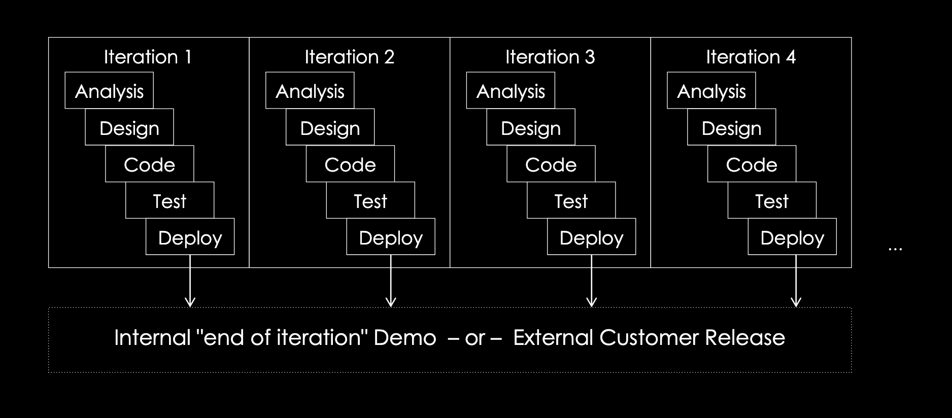
The ‘totally new’ Agile development process

Slide 36
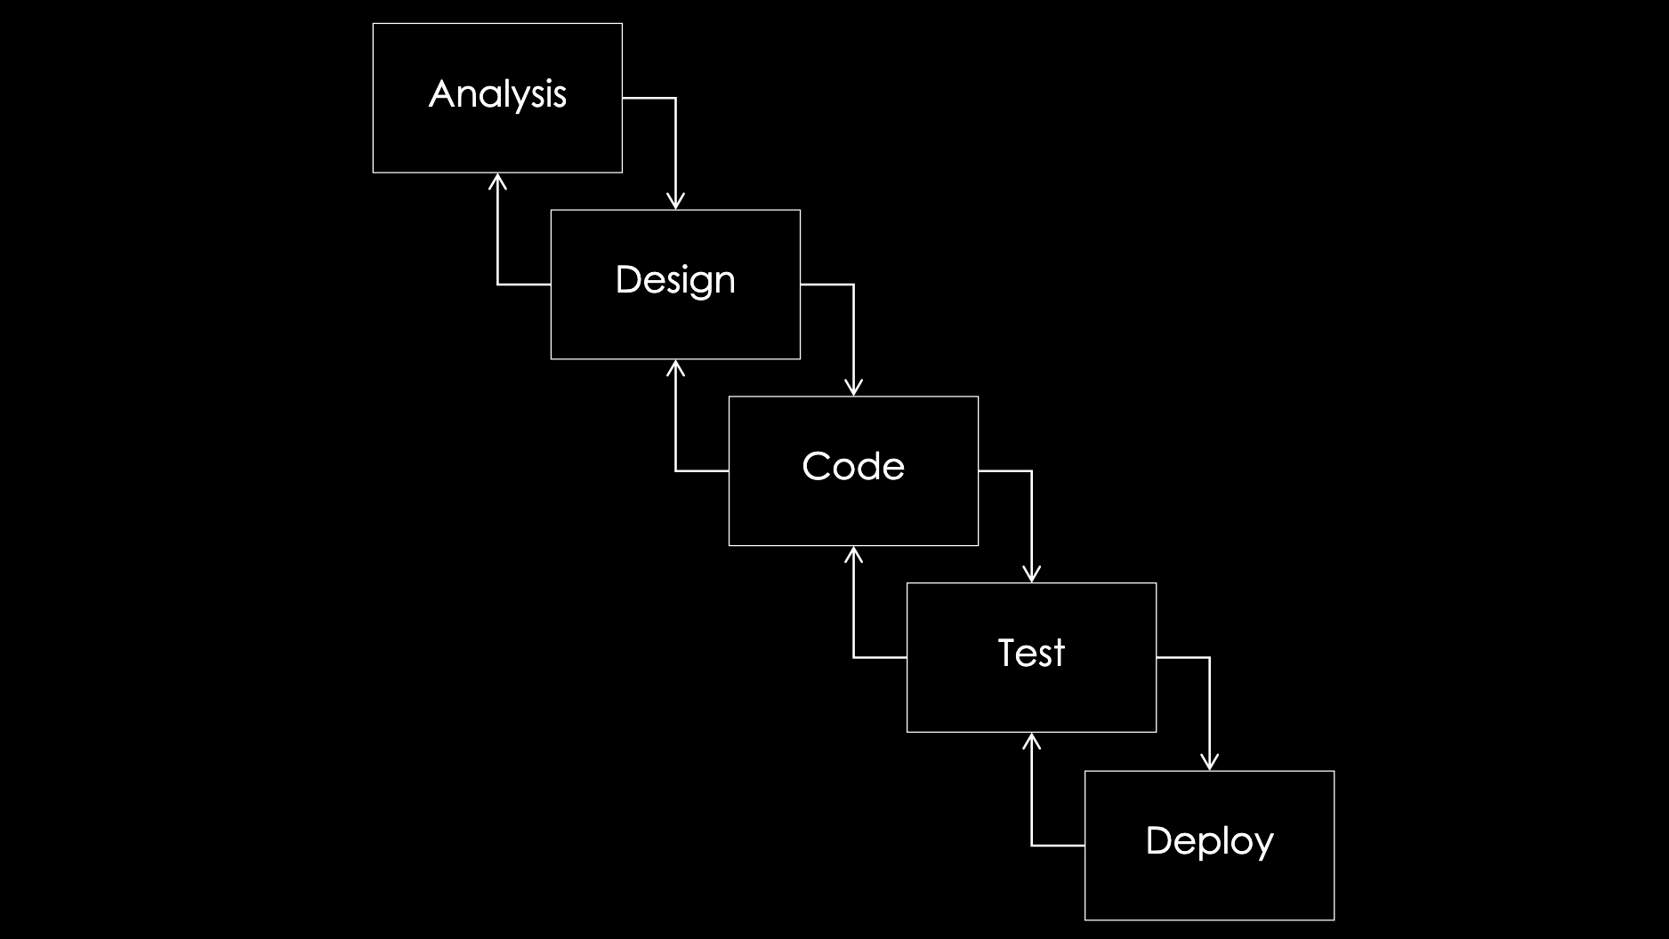
The ‘old fashioned’ generic waterfall

Slide 37
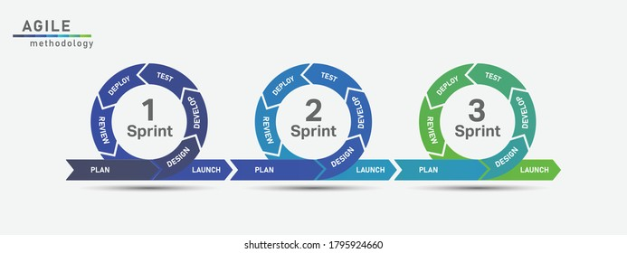
What does Agile look like in SEP?

Slide 38
Agile sprints
Sprints are reoccurring (usually) 2-3 week periods in a longer project
allow a team to organise and think about tasks in smaller time chunks.
Start with meetings to discuss all the work teams believe can be completed in the sprint.
This becomes tasks with definable, concrete goals
which can be evaluated to determine if the task has been completed.

Slide 39
SEP Sprints
SEP is divided into 3 sprint equivalents:
Minimum Viable Product phase (now until Week 9)
Beta phase (Week 10 to Week 17)
Final phase (Week 18 to Week 24)
BUT! You can have more sprints! This is the minumum

Slide 40
Regular Standups
(A.K.A Daily Standup or Daily SCRUM)
Short meetings to keep team members updated on each individual's progress as a sprint progresses.
”Stand ups” because everyone stands up so that no one gets comfortable enough to allow the meeting to go on for too long –
15-20 minutes.

Slide 41
Regular Standups
Each team member will talk about
what they have done
what they are *blocked* by
what they are going to do.
Everyone gets a quick update on other's progress
Invites team members to help each other with tasks they are blocked by.

Slide 42
Regular Standups
To keep this meeting on track, is the *SCRUM Master*
Directs the agenda
Makes sure everyone is heard
Keeps the meeting quick and relevant
In industry: daily
In SEP: aim at once or twice a week (eg beginning and end)

Slide 43
Communication
Teams that do well in SEP communicate continually!
But communication doesn’t need to take a lot of time
We recommend having somewhere you’re communicating
Ideally with channels and ways to organise conversations and somewhere you can have video/audio calls
Teams or Discord
NOT WhatsApp! NOT where you socialise!

Slide 44
Standup advice
Agree a set format in advance, so you come prepared
Rotate the Scrum Master so everyone takes regular turns leading the meetings
Ask your mentor for advice!
Record everything you’re doing/have done on the kanban board
(We can’t give you marks if we can’t see it!)
Use the kanban board as meeting notes/agenda

Slide 45
Standup advice
Agree a set format in advance, so you come prepared
Rotate the Scrum Master so everyone takes regular turns leading the meetings
Ask your mentor for advice!
Record everything you’re doing/have done on the kanban board
(We can’t give you marks if we can’t see it!)
Use the kanban board as meeting notes/agenda

Slide 46
This is not the only meeting!
Stand-ups are NOT the only time you’re meeting!
Regular sessions for working together (Wednesdays)
Planning
Designing
Pair programming
Working on different tasks in the same place
Teaching each other about the things you’ve made

Slide 47
Starting your Agile process
TOMORROW
Meet your team-mates
Arrange when/where/how often to meet
Agree a client liaison and send out initial email
Contact your mentor and arrange to meet them
Start working on your Repo
Put your first tasks on the Kanban board

Slide 48
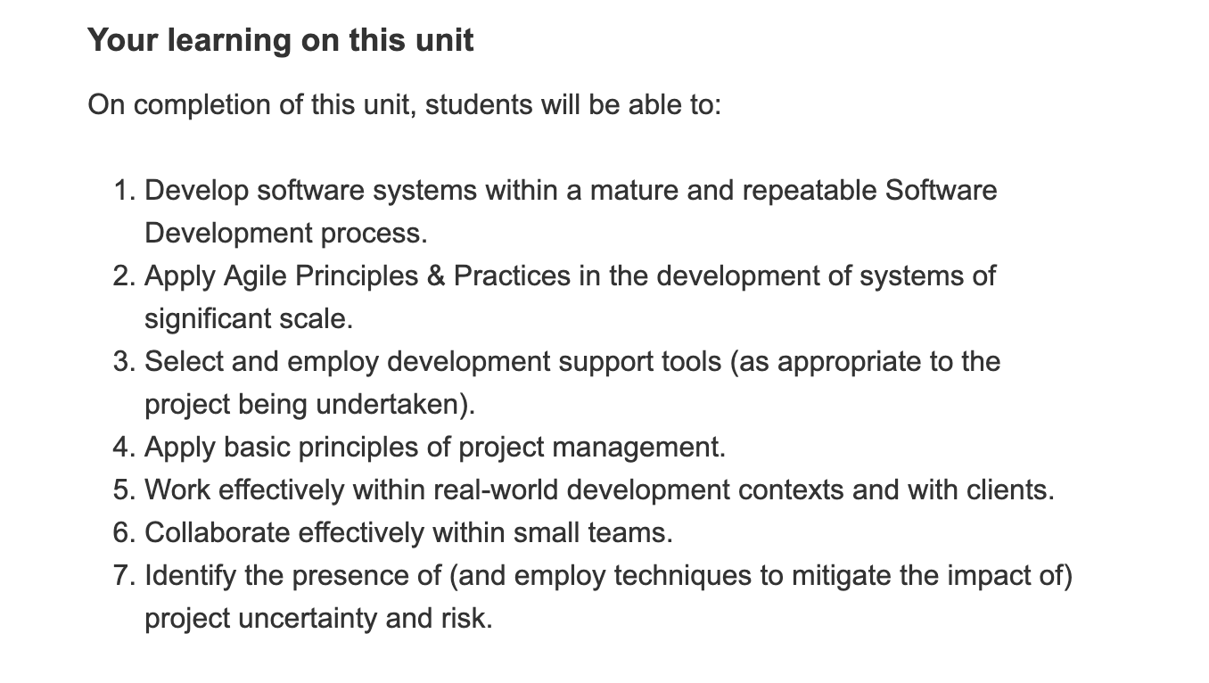

Agile is non-negotiable!

Slide 49
What is a Kanban board?
A useful concept taken from the Kanban method.
A flexible 'ToDo' list structure, where issues progress through various states:
"ToDo” -> "In Progress" -> "Done”
Originally post-it notes on a whiteboard, now there are various digital tools to help you.
We are using the GitHub version, called "Projects".

Slide 50
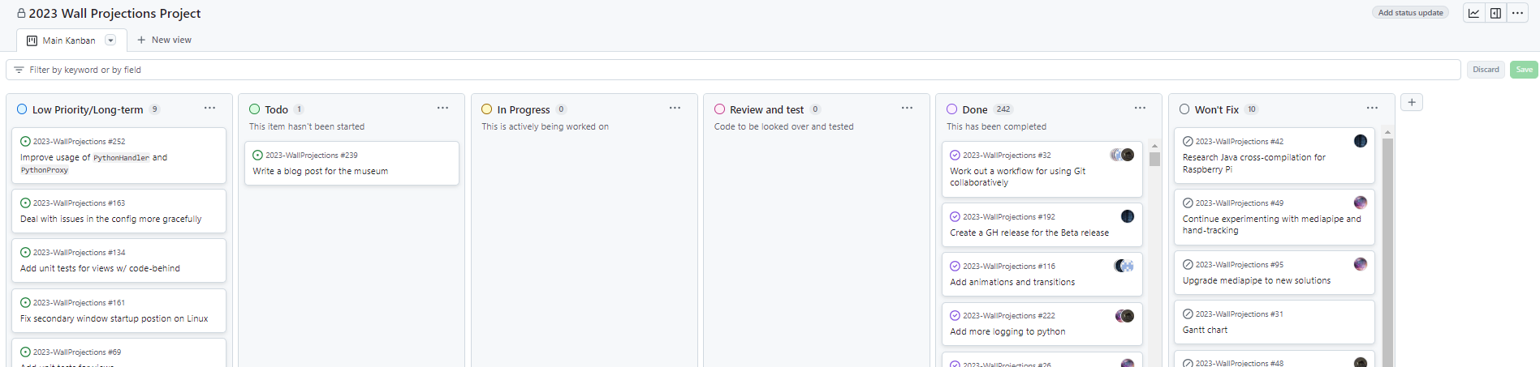
Example Kanban

Slide 51
Where do you start?

Slide 52
Requirements engineering
The process of establishing the features that the client requires from a system
and the constraints under which such features must operate
The requirements are the recorded description of the system features and the constraints that are generated during this process.
We will talk to you more about this in the coming weeks, but the
task starts with your first client meeting

Slide 53
Dangers of not doing Requirements Engineering
We must find out what to build before we build it!
Common trap: to think we know what the client wants and blaze ahead building it….
…only to realise later we were wrong!
Having wasted time, effort and money (grades)

Slide 54
Eliciting requirements
How do we actually find the requirements?
We don’t just know them intuitively
(a rookie developer mistake is to think that you can!)
We have to actually make an effort to find them
They can be elicited using a variety of techniques…

Slide 55
Reading documentation
We’ll talk about this more in Week 3
Organisations often have a lot of documentation:
process documents, regulations, manuals, etc
Ask your client for theirs!
If we can get hold of them and pick them apart, we can understand how the organisation operates and then specify requirements to support that operation

Slide 56
Reading documentation
BUT!
Be aware that people don’t always follow official regulation!
Being able to identify work-arounds being used is essential!

Slide 57
Interviews
An obvious way to find out about an organisation is to talk to people (workers, managers, customers)
This may be an informal chat over coffee
Or a formal, planned, structured interview
Be open-minded and avoid pre-conceived notions.
You can prompt the interviewee to get discussions going by using a ‘springboard’ question…
BUT do try to listen to their answers!

Slide 58
Observation
Another way to identify requirements is by observation
Watch the ‘lived’ practices within an organisation
Social and organisational factors may be observed
Some social scientists (ethnographers) are explicitly trained in the observation and analysis of work
But it is possible to undertake our own studies

Slide 59
Systems analysis
Existing systems encapsulate work practices
• If we analyse/deconstruct them, we gain insight
• Reverse engineer systems to derive requirements
• BUT…. This assumes existing systems are good
• If they are that good, why build something new?

Slide 60
Problems with Requirements Analysis
Stakeholders will express their needs in their own words
• This may be in the technical jargon of their field
• They may struggle to articulate what they want
• Or use concepts that only make sense to them!
• Different stakeholders often have conflicting needs - how can you reconcile these?
• Stakeholders frequently don’t know what they want
• Often they don’t even know what they currently do (or at least can’t explain)

Slide 61
Problems with Requirements Analysis
Organisational and political factors may be present
Development is not just a technical challenge, but a human one
Requirements may change during the analysis process
New stakeholders emerge or the environment changes
Different people in the organisation may contradict each other
People might not know what’s possible or not

Slide 62
How to solve these problems
If you’re unclear about anything the client says, ask them!
Never pretend you understand things you don’t – the clients will always prefer you stop and check
Send them emails after the meeting to confirm what you think you were told
If you’re unclear what things mean, or need help, talk to your mentor and come to the Drop-Ins on Fridays for help

Slide 63
How to solve these problems
Use your first meeting to start your Requirement Engineering Process
Ask the client if they can share information about the existing systems and their organisation
Ask if you can plan another meeting specifically for Requirement Engineering – don’t assume this is something you can do in your first meeting
Ask if you can come and observe their work – but don’t be surprised/upset if they say no (they are very busy)

Slide 64
What do you need to know?
Who are your Stakeholders?
Anyone who might be impacted by the system
and who might impact the system
even if they don't directly interact with the system.

Slide 65
Typical stakeholders
End users
Organisation and system managers
Organisation and system owners
General public who are affected by the system - this can be directly (e.g. people who want to use Community Transport) and indirectly (businesses/services/people expecting others to use Community Transport)
Legislators (for example, with an interest in GDPR and data privacy)

Slide 66
User stories
Once we have identified a set of stakeholders for a project, we can start to think about what these individuals and organisations might need from a system. We do this through identifying User Stories.
A popular way to record user stories is:
As a [type of user], I want to [some goal], so that [some reason]
Or to put it more technically:
As a [persona], I want to [action], so that [benefit].

Slide 67
User stories
For example:
As a chef, I want to be able to identify how long it takes to cook meals, so that I have time to cook and deliver and order in a reasonable time.
As a diner, I want to be able to order a meal, so that I can eat it and no longer be hungry.
As a diner, I want to try a dish I’ve never tasted before, so that I can experience something new and taste new flavour combinations.

Slide 68
Flow
Once you have identified your user stories, you next identify the "flow" steps.
The "basic flow" is the normal or typical sequence of steps involved in achieving the goal.

Slide 69
Flow
For example, in a restaurant, when a customer wants a meal, the customer flow steps are:
Consider menu
Pick starter
Pick main course
Attract waiter's attention
Place order
Waiter passes order to chef
Chef confirms order with waiter

Slide 70
Flow
However, be aware that interaction does not always follow the basic flow:
Alternative flow:
Another, equally valid, but perhaps less common sequence of steps
(sometimes you choose the main course before the starter!)
Exceptional flow:
Unusual path to cope with strange or undesirable behaviour
(you see the price of the food and slip away quietly!)

Slide 71
Before you meet your client
In your team, think about who your client’s stakeholders might be, and write a few user stories with flow steps, and add them to your README.
You won’t yet have much detailed knowledge regrading your project,
so take a best guess.
When you meet with your client, you can use this as a starting point for discussion.
User Stories can and should evolve over time as you gain more knowledge and insight into your application domain.

Slide 72
What else will you do tomorrow?
Meet your team!
Plan where/when/how you will meet
Start your Kanban Board
Agree a client liaison and email the client to arrange your first meeting
Contact your mentor and arrange the first meeting
Start your README:
* Project description * Stakeholders * User stories
Think about your Contract with your client
Think about Data Protection and Ethics for your projects

